Slide 1

Academic Affairs 2022-23 Critical metrics and activities
Scott R. Furlong, Provost/VPAA/VPEM SUNY Oswego

Slide 2
Agenda
Enrollment – Updates, Planning
Student Success Equity Intensive (SSEI)
Data
Projects
First Year Seminars
Other items

Slide 3
6,800 is truly extraordinarily low.
Let’s dig a bit deeper to understand where we were, where we are, and where we might be going.
Notes:
What does a 1,000-student decline mean?
$7.1 million less tuition revenue every year
$1.7 million less in fee revenues to run vital programs
Assuming students would have lived on campus for two years, $7.9 million less room and board revenue
In all, about $17 million less every year
The average full-time faculty member at Oswego earns ~$75,000. Resolving just the $7.1 million tuition loss through faculty cuts would require eliminating 93 full-time positions ... or about a quarter of FT faculty.

Slide 6
Online program growth
Truly moving into new service markets -- older and more part-time: 45% of undergraduates aged 26 or older are in on-line programs, compared to only 3% of younger undergraduates. Similarly, 26% of undergraduates attending part-time are in on-line programs, compared to only 4% of full-time undergraduates.

Slide 7
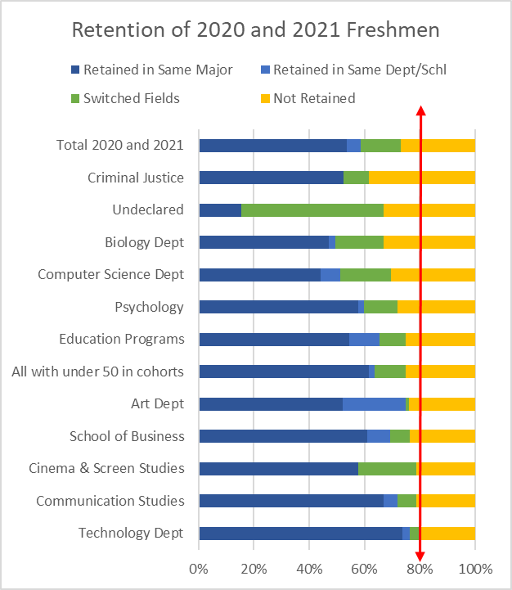
Retention contributes
Notes:
Red arrow is the 80% goal.
If we retained 80% of 1500 freshmen we would have over 100 more sophomores than if we retain 73% of them.

Slide 8
Retention, continued
 | Cohorts 2020 and 2021 | Retained in Same Major | Retained in Same Department or School | Switched Fields | Not Retained | Retained
Technology Dept | 72 | 74% | 3% | 4% | 19% | 81%
Communication Studies | 175 | 67% | 5% | 7% | 21% | 79%
Cinema & Screen Studies | 52 | 58% | 0% | 21% | 21% | 79%
School of Business | 425 | 61% | 8% | 7% | 24% | 76%
Art Dept | 92 | 52% | 23% | 1% | 24% | 76%
All with under 50 in cohorts | 449 | 62% | 2% | 11% | 25% | 75%
Education Programs | 263 | 54% | 11% | 10% | 25% | 75%
Psychology | 204 | 58% | 2% | 12% | 28% | 72%
Computer Science Dept | 109 | 44% | 7% | 18% | 30% | 70%
Biology Dept | 261 | 47% | 2% | 18% | 33% | 67%
Undeclared | 224 | 16% | 0% | 51% | 33% | 67%
Criminal Justice | 107 | 52% | 0% | 9% | 38% | 62%
Total 2020 and 2021 | 2433 | 54% | 5% | 14% | 27% | 73%
Statistical predictions of retention show that the primary factor is students’ grades, followed by some demographic variables (gender, minority background). Once those things are held in check, field of study does not predict retention. Areas with low retention rates have low rates because their students have low grades… statistically speaking.

Slide 10
Five year plan outline

Slide 11
New Fall 2023 Undergraduate Update
Will we reach last year’s totals? Can we grow even more? Or will the 2023 classes be smaller?
Freshmen –
4/16/23 4/16/22
Applications 14630 12122
Deposits 654 732
Transfers –
4/16/23 4/16/22
Applications 1301 1037
Deposits 195 152

Slide 12
Student Success Equity Intensive S S E I
Belongingness: gaps based on race/ethnicity, first-generation status, sex/gender orientation, and income (Pell) status
Financial stability: gaps based on income status
Credit Completion: gaps between racial/ethnic groups

Slide 13
Belongingness
Some data
The plans:
GST 104
FYS on voluntary basis
Gender inclusivity data collection, assessment and program development
Communication plans for First Generation Students; “First Lakers” identify development
Work to increase funding for multicultural student organizations through Student Association
Multicultural and other Living-Learning Community pilots
Inclusive Teaching faculty and staff development
Peer mentoring

Slide 14
Financial stress/stability
Some data (National College Health Assessment)
The plan:
Student financial aid mentors
Financial Literacy modules to push into classes and into student orgs
Office hours for peer-to-peer
Included in Title III grant request
Financial Literacy work will also be embedded into a full-time position, taking advantage of a pending retirement
Institutional Scholarship review committee

Slide 15
Credit completion
Some data
The plan:
Embedded tutoring
May focus on lower-level math courses, due to their difficulty and importance across the curriculum
Faculty development funding is included in Title III grant request
First-year Seminars – on voluntary basis

Slide 16
Credit completion, Belongingness, and degree attainment is the domain of the faculty
High Impact Practice Areas | Potential for First year Impact | Universally Available or Required | Comments
Capstone Courses and Projects | No | Yes | Structure varies by major
Collaborative Assignments and Projects | Possible | No | Any use of this HIP is on a teacher-by-teacher basis right now
Common Intellectual Experiences | Possible | Yes | GST 104 will be common, but does not focus on intellectual development
Diversity Learning | Possible | Yes, Gen Ed | Not a freshman focus currently
Global Learning | Some | No | Not a freshman focus
ePortfolios | No |  | Not used here
First-year Seminars | Yes | No | Voluntary basis
Internships | No | No | Access and use varies by major
Learning Communities | Possible | No | Not used here currently; Student Affairs is studying
Service Learning | Possible | No | Limited use through some GST courses; voluntary basis
Undergraduate Research | No | No | Access and use varies by major
Writing-Intensive Courses | Yes | Yes | Heavy reliance on adjunct and visiting faculty for ENG 102

Slide 17
Activities & events
Great Lakes Institute
Rich and Pour Café
SUNY CIT Conference (May 23 – 26)
Romeo and Juliet; BFA Shows; State Singers/College Choir
QUEST – April 19th and April 18th at 5:30 at Syracuse campus
Serving our access mission with online programs (IPS, Business, others) and minors; microcredentials; work on PLA
Library Research Party (April 25)

